Slide 1

Transition and
Individualized Education Program
Updates

Slide 2
What is Transition?
A coordinated set of activities for a child with a disability that—
  Is designed to be within a results-oriented process that is focused on improving the academic and functional achievement of the child with a disability
  Is based on the individual child’s needs, taking into account the child’s strengths, preferences, and interests.
Source: Individuals with Disabilities Education Improvement Act of 2004
Notes:
Facilitator’s Notes:

Slide 3
When is Transition Addressed?
Beginning not later than the first IEP to be in effect when the student is 16, or earlier if appropriate, and updated annually thereafter.
Transition must be addressed for students who will turn age 16 during the implementation year of the IEP.
Transition must be addressed for all students entering the 9th grade, regardless of age.
Notes:
Facilitator’s Notes:

Slide 4
What is Transition Planning?
Transition Planning
Assess
Plan
Instruct
Evaluate
A
P
I
E
Adapted from Test, D. W., Aspel, N., & Everson, J. (2006). Transition methods for youth with disabilities. Columbus, OH: Merrill/Prentice Hall.

Slide 5
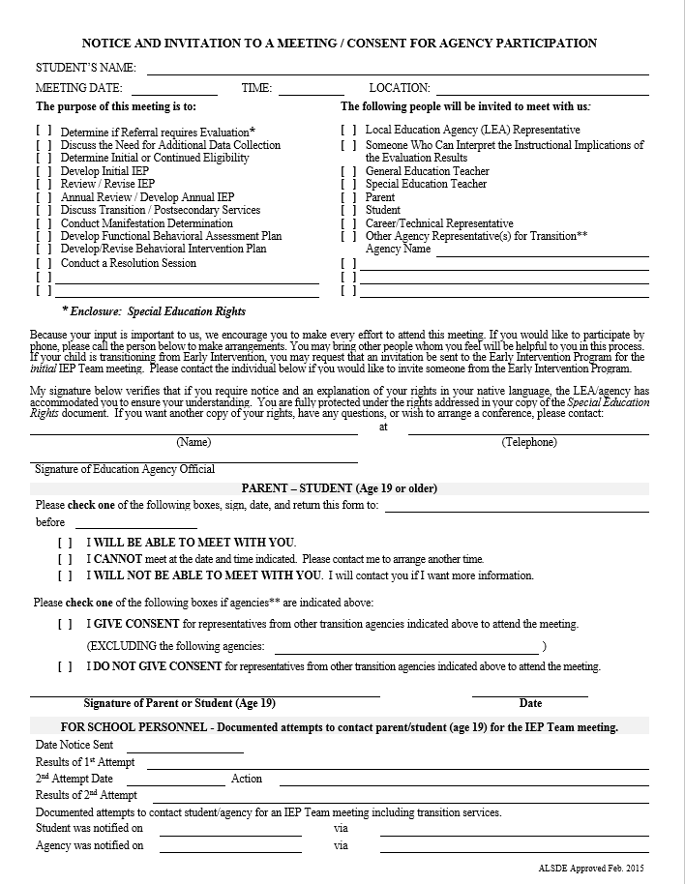
NEW
NOTICE AND INVITATION TO A MEETING / CONSENT FOR AGENCY PARTICIPATION

Slide 6
PLEASE NOTE:
THE FOLLOWING IS ONLY
AN EXAMPLE!
DISCLAIMER
Notes:
PLEASE NOTE: THE FOLLOWING EXAMPLE IS ONLY ONE WAY
TO DEVELOP A STANDARDS BASED IEP

Slide 7
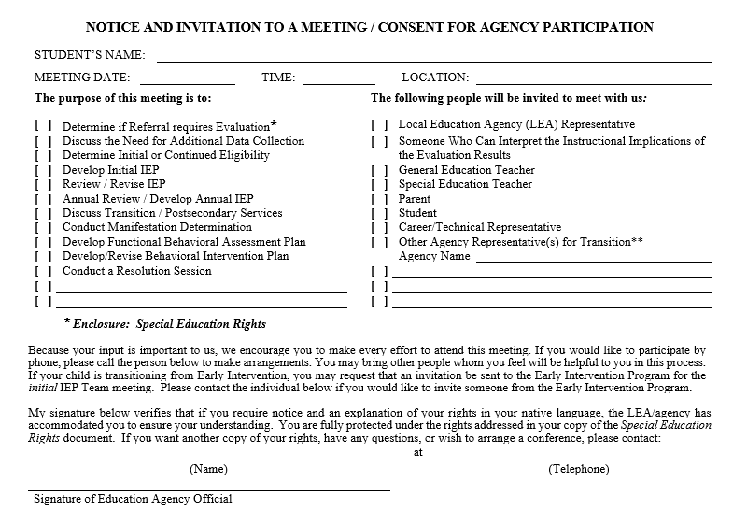


Student’s name
05/19/2015
1:30 p.m.
Lee High School Rm 205
Special Education Teacher
205-555-1234
LEA’s signature

Slide 8
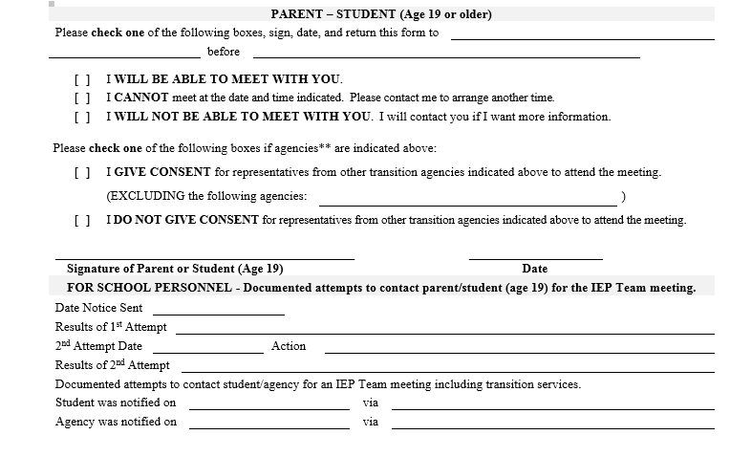

First and Last Name
05/14/2015
Parent’s signature
05/o2/2015
05/02/2015
Parent signed and agreed on date and time
5/02/2015
Conference to discuss reason for meeting
Notes:
Facilitator’s notes:
• Record the date that the invitation was sent to the parent and student (age 19 and older) and the results. If there is no response (or if the response is to reschedule the meeting) after the first invite is sent, a second contact must be made and the date of the contact recorded on this form. The action and results of the second contact must be documented.
• Record the date that the invitation was sent to the student and/or agency and how they were informed for all meetings that the student and/or agency are invited to attend.
• All students who will be age 16 and older during the implementation of the IEP must be invited to the IEP Team meeting.
• Agency representatives for transition who may be providing or paying for transition services may not be invited without consent from the parent or student (age 19 and older).
What happens next:
• If the parent or student (age 19 and older) checks I WILL BE ABLE TO MEET WITH YOU no further action is required. If the parent or student (age 19 and older) checks this option, but does not attend the meeting or is not available by phone as scheduled, the meeting may be held with the other required IEP Team members.

Slide 9
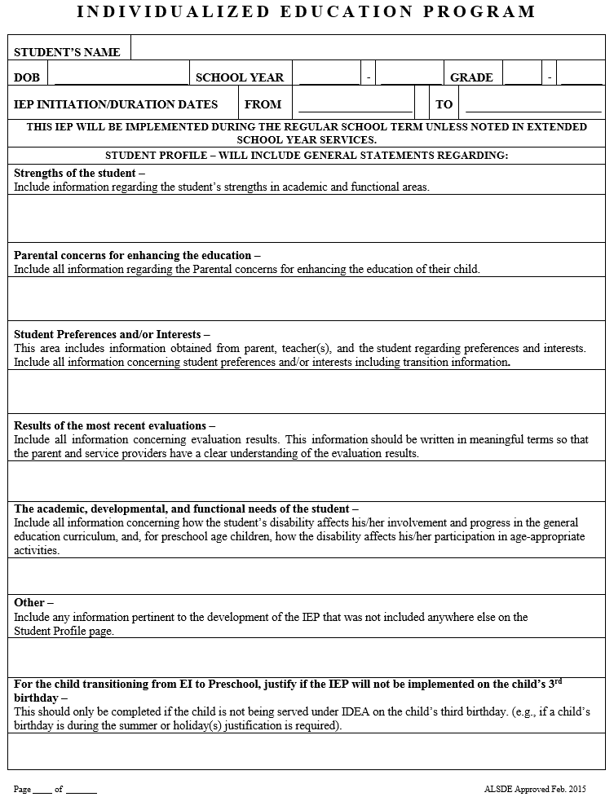
Include transition-related
information

Slide 10
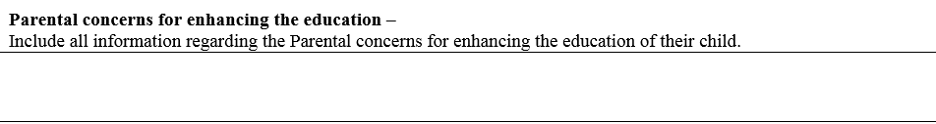
Parental concerns for enhancing the education-
Include all information regarding the Parental concerns for enhancing the education of their child.
The student’s mother stated that it is important for the student to finish high school and it would be beneficial for the student to spend his day working on skills that will prepare him for life after high school. His mother stated that he needs as much support as possible.

Slide 11
Student Preferences and/or Interests—
This area includes information obtained from parent, teacher(s), and the student regarding preferences and interests. Include all information concerning student preferences and/or interests including transition information.
According to the O*NET Career Exploration Tools, the student is interested in becoming an automobile mechanic. According to this transition assessment, it appears that the student has abilities that closely match his work-related interests. An interview with the student’s mother indicated that he helps at his uncle’s automobile shop on the weekends. According to his mother, the student assists his uncle with minor repairs and is likely to be a dedicated employee. The student’s uncle gives him a weekly allowance for helping him at the shop.
According to the student, he has responsibilities at home that includes caring for his younger siblings and doing light chores around the house. He enjoys working with others and doing manual labor. He enjoys fixing appliances around the house and working with his dad outdoors.
According to the Kuder Skills Confidence Assessment, the student has skills to succeed as an automobile mechanic. The results of this assessment matched the occupation, pathways, and occupational clusters of the O*NET Career Exploration Tools assessment. According to the Kuder Skills Confidence Assessment, the student believes he has the ability and skills to become an automobile mechanic.
According to the Casey Life Skills assessment, the student has knowledge about community resources, daily living activities, computer literacy, and career planning. The student lacks housing and money management skills, work and study habits skills, and self-care skills.
According to the school’s counselor, the student stated that although it may be challenging, he is determined to become an automobile mechanic. He also stated that he wants to attend a community college or technical school to earn a degree or certificate.
According to the most recent transition assessments, student, parent, and teacher interviews, the student is interested in attending a community college or technical school and pursuing a career in the automotive technology industry.

Slide 12
Results of the most recent evaluations—
Include all information concerning evaluation results. This information should be written in meaningful terms so that the parent and service providers have a clear understanding of the evaluation results.
The student is currently a sophomore and is pursuing the Alabama High School Diploma through the Essentials/Life Skills Pathway. According to curriculum based assessments, the student is currently passing all of his courses. He participates in group activities, discussions, and requires minimal assistance in the general education classroom. According to grade level assessments and the Kaufman Test of Educational Achievement, Third Edition (KTEA-3), the student’s current reading ability is equivalent to a student in the seventh grade. His performance on reading comprehension is inconsistent. He is able to read most of the grade level materials, but has difficulty answering questions. He is able to decode unknown words and has a good sight word vocabulary. According to the KTEA-3, his math ability is equivalent to a student in the seventh grade.

Slide 13
Other-
Include any information pertinent to the development of the IEP that was not included anywhere else on the Student Profile page.
According to the student’s teachers, he attends the general education classroom for all of his courses and requires minimal accommodations. All of his teachers stated that he takes on a leadership role whenever possible and behaves appropriately in the classroom. His special education case manager stated that he participated in a community science fair with his friends and demonstrated great teamwork.

Slide 14
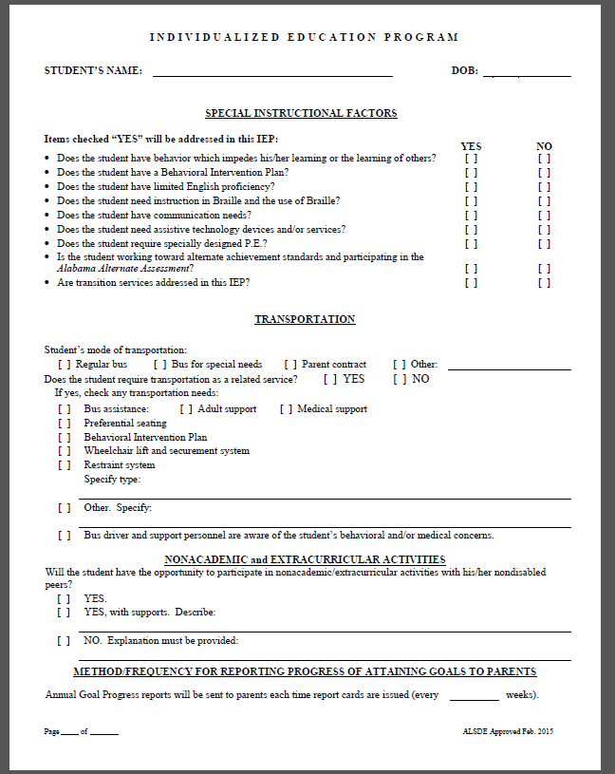
Items checked “YES” must be addressed in the IEP

Slide 15
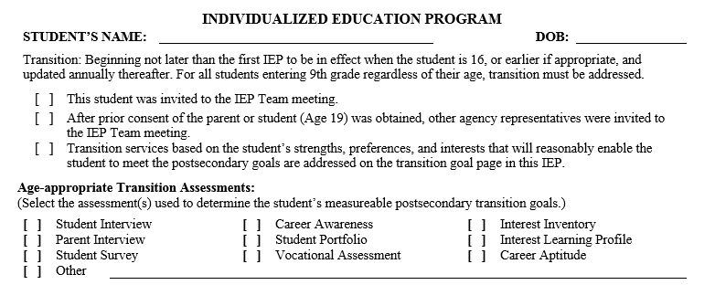


New
KTEA-3

Slide 16
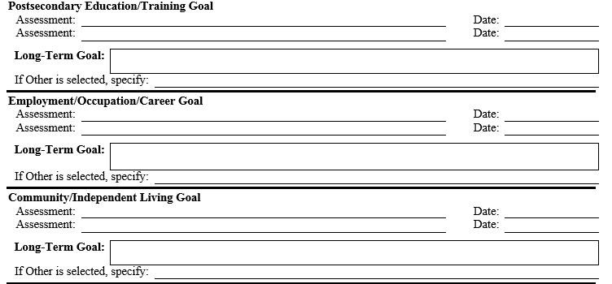
Long-Term Post-Secondary Transition Goals

Slide 17
Assessments Used to Determine Long-Term Postsecondary Transition Goals Must Be Addressed
New

Slide 18
Long-Term Post-Secondary Transition Goals
New
KTEA- 3
04/15/2015
O*NET Career Exploration Tools
01/23/2015
O*NET Career Exploration Tools
01/23/2015
Interviews and Observations
01/14/2015
Casey Life Skills
01/12/2015
Interviews and Observations
01/14/2015

Slide 19
Long-Term Post-Secondary Transition Goals

Slide 20
Long-Term Post-Secondary Transition Goals
Student will be prepared to participate in a technical or non-degree education program based on completion of IEP goals, high school program, and submission of application for enrollment.
The student will be prepared to engage in career-related planning leading to the selection of a career
based on personal career interests, aptitudes, abilities, and occupational information.
Student with time-limited support will be prepared to participate in both community activities and live independently
based on independent living skill level achieved and identification of community/living options.

Slide 21
Long-Term Post-Secondary Transition Goals
KTEA-3
04/15/2015
O*NET Career Exploration Tools
01/23/2015
Student will be prepared to participate in a technical or non-degree education program based on completion of IEP goals, high school program, and submission of application for enrollment.
O*NET Career Exploration Tools
01/23/2015
Interviews and Observations
01/14/2015
Student will be prepared to engage in career-related planning leading to the selection of a career based on personal career interests, aptitudes, abilities, and occupational information.
Casey Life Skills
01/12/2015
Interviews and Observations
01/14/2015
Student with time-limited support will be prepared to participate in both community activities and live independently based on independent living skill level achieved and identification of community/living options.

Slide 22

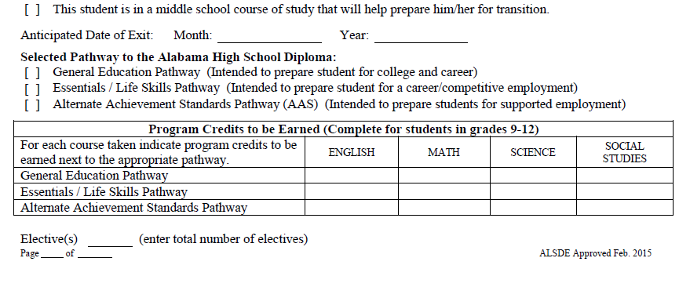

May
2018
1
1
1
1
3

Slide 23
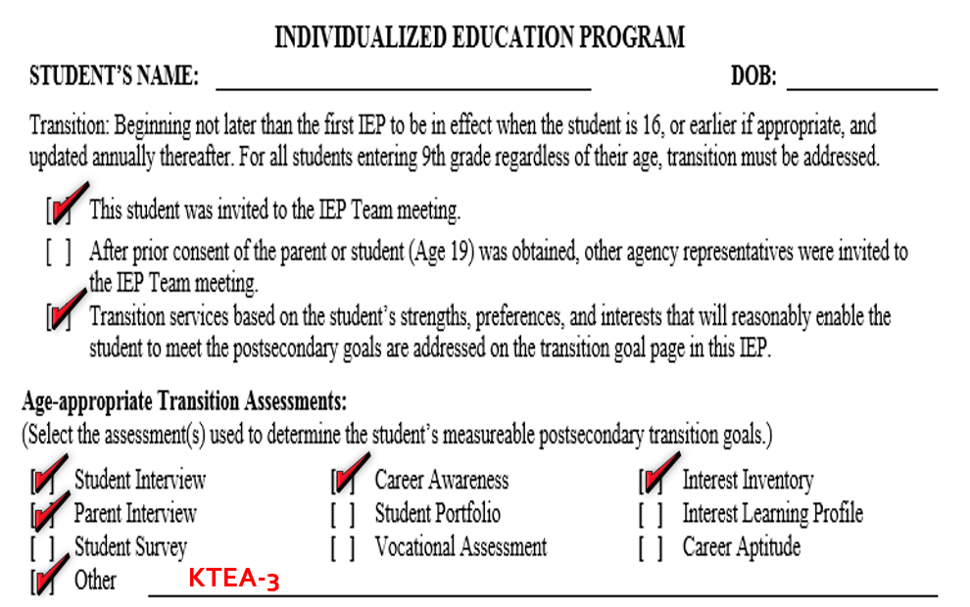
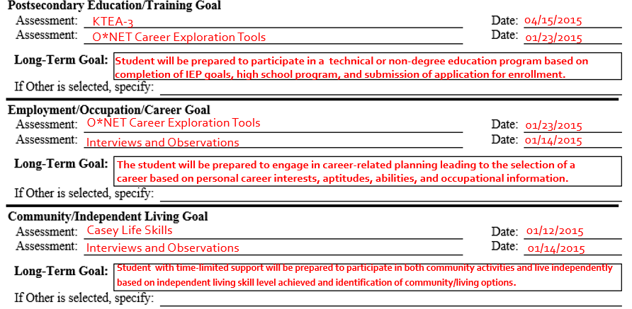
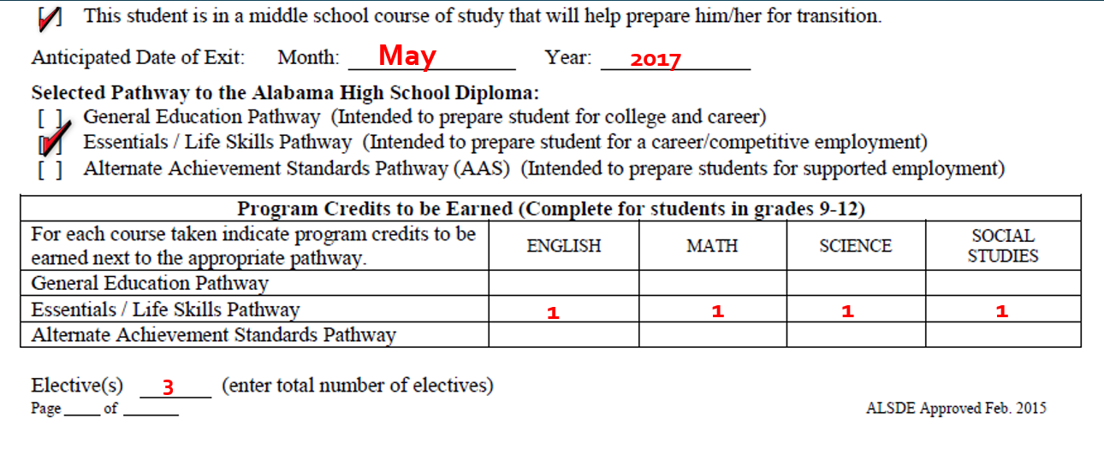

Slide 24
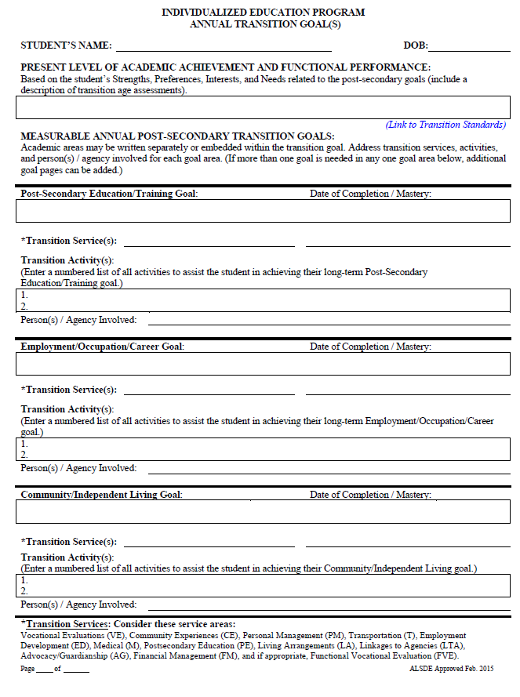
New
ANNUAL TRANSITION GOAL(S)

Slide 25
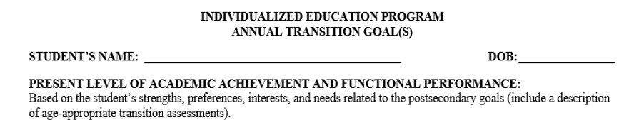

Slide 26
The student attends classes regularly and seems to enjoy school. He is currently working towards the Alabama High School Diploma on the Essentials/Life Skills Pathway. He has a strong desire to become an automobile mechanic and wants to attend a community college or technical school when he graduates from high school. According to the O*NET Career Exploration Tools assessment, the student has skills that match his interest to become an automobile mechanic. According to the Casey Life Skills assessment, the student has knowledge about community resources, daily living activities, computer literacy skills, self-care skills, and career planning. He lacks housing and money management skills and work and study habits skills. Student’s lack of specific job competences negatively affects his progress related to the work and career field that matches his skills and abilities.

Slide 27
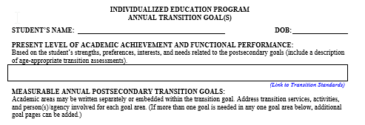
NOTE: Once a standard is selected that most closely fits the needs for academic and/or functional achievement for the coming year, the IEP team must then “convert” or “translate” that standard, or its functional essence, into the most pertinent annual goal possible.

Slide 28
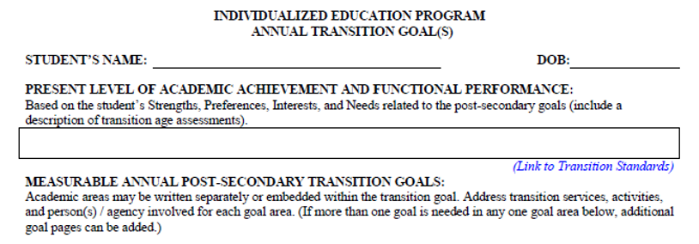
Transition Standard
Postsecondary/
Education Training
Annual Goal
Postsecondary Education/Training Annual Goal
By the end of 36 weeks, the student will acquire organizational skills and practice study strategies that will enhance his study habits and support his postsecondary education/training (TS.AT.10.3B) by earning classroom based assessments of at least 80%. Through progress monitoring, the student will obtain an 80% average in classroom based assessments.

Slide 29
Transition Standard Employment/
Occupation Career Annual Goal
Employment/Occupation/Career Goal
By the end of 36 weeks, the student will describe the importance of earning wages and set up a checking and/or saving account at the local financial institution (TS.OC10.4b). Given direct instruction and practice on how to make currency bank deposits, the student will demonstrate currency bank deposits with 100% accuracy.

Slide 30
Transition Standard
Community/ Independent Living Annual Goal
Community/Independent Living Goal
By the end of 36 weeks, the student will develop a post-school plan including a budget based upon his projected income and possible living arrangements (TS.DL11.2.B).

Slide 31
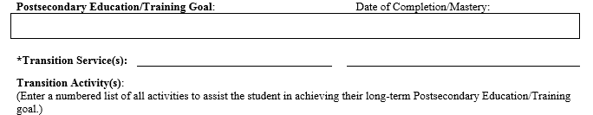

By the end of 36 weeks, the student will acquire organizational skills and practice study strategies that will enhance his study habits and support his postsecondary education/training (TS.AT.10.3B) by earning classroom based assessments of at least 80%. Through progress monitoring, the student will obtain an 80% average in classroom based assessments.
Personal Management (PM)
Postsecondary Education (PE)
Notes:
Transition Services: (Pause)
Transition Services are needed for students to reach his or her postsecondary education/training goal, employment/occupation/career goal and community/independent living goal.
One or more Transition Services must be addressed each year for students age 16, or earlier if appropriate, for students entering 9th grade, and updated annually thereafter.
A list of the Transition Services can be found on the bottom of the Annual Transition Goals Page document and a description of the Transition Services can be found in the Mastering the Maze document
For this student, in the Postsecondary Education/Training Goal area, the IEP Team selected Personal Management (PM) and Postsecondary Education (PE) for the needed Transition Services. The IEP Team determined that these areas will provide the student with services that will provide instruction in managing personal responsibilities and activities in adult areas and prepare him for postsecondary education/training.
Click

Slide 32
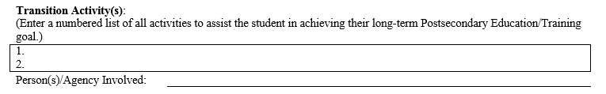

Slide 33

Examples of Transition Activities

Slide 34
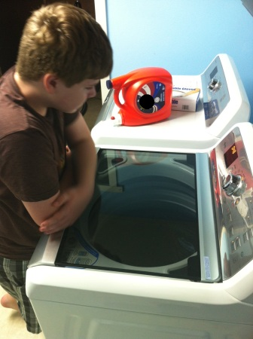
DAILY LIVING SKILLS
Learn to operate washing/dryer
Learn to practice basic self-care
Care for personal toileting needs
Manage daily time schedule
Learn emergency procedures

Slide 35

EMPLOYMENT
Complete application to Vocational Rehabilitation Services
Participate in community work experiences
Attend transition fair/career fair at school
Open a bank account
Participate in work experience/job shadowing

Slide 36
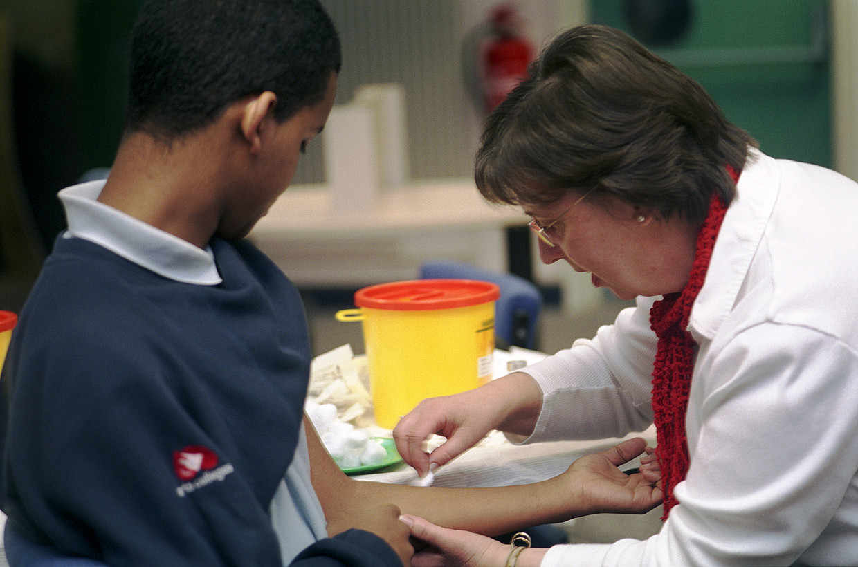
RELATED SERVICES
Complete an assistive technology evaluation
Work with school health nurse on medication management
Participate in rehabilitation counseling
Participate in social work services
Connect with local community mental health centers for services

Slide 37

EDUCATION
Learn and practice social skills
Learn and practice employability skills
Research colleges and/or careers and requirements
Participate in Drivers Education training
Participate in community-based instruction

Slide 38

COMMUNITY EXPERIENCES
Practice budgeting and shopping skills
Use public transportation to get to and from work site
Locate items in a grocery store
Plan and participate in community activities
Explore and tour living and housing options

Slide 39
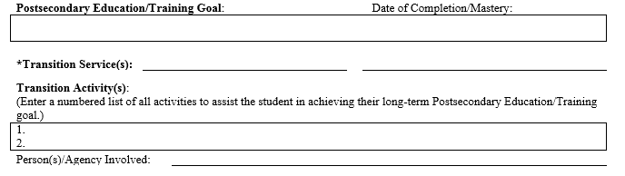
By the end of 36 weeks, the student will acquire organizational skills and practice study strategies that will enhance his study habits and support his postsecondary education/training (TS.AT.10.3B) by earning classroom based assessments of at least 80%. Through progress monitoring, the student will obtain an 80% average in classroom based assessments.
Personal Management (FM)
Postsecondary Education (PE)
Student will take study skills or other specific courses to increase learning strategies.
Student will use a daily planner to organize school work and homework assignments.
Student, Parent, and Special Education Case Manager
Notes:
For this student, the IEP Team determined that these transition activities will assist the student in reaching his annual measurable goal.
(Read the transition activities)
The IEP Team also identified the people involved with the transition activities
(Read Person(s)/Agency Involved)
Click

Slide 40
Postsecondary Education/Training Annual Goal
By the end of 36 weeks, the student will acquire organizational skills and practice study strategies that will enhance his study habits and support his postsecondary education/training (TS.AT.10.3B) by earning classroom based assessments of at least 80%. Through progress monitoring, the student will obtain an 80% average in classroom based assessments.
Transition Service
Personal Management (PM) Postsecondary Education (PE)
Activities
1. Student will take study skills or other specific courses to increase learning strategies.
2. Student will use a daily planner to organize school work and homework assignments.
Person(s)/Agency Involved
Student, Teachers, Parent, and Special Education Case Manager
Notes:
Let’s take a look at the completed required components of the IEP for the Postsecondary Education /Training Annual Goal for this student.
The IEP Team Developed an individualized measurable annual transition goal based upon the Alabama Transition Standards (Click)(read slide)
The IEP Team Selected the Postsecondary Education (PE) for the needed Transition Service (Click) (read slide)
The IEP Team Developed two transition activities (read slide) The IEP Team determined that these transition activities will assist the student in reaching the annual measurable goal.
The IEP Team also identified the people responsible involved in the transition activities (Click) (read slide)

Slide 41
Employment/Occupation/Career Goal
By the end of 36 weeks, the student will describe the importance of earning wages and set up a checking and/or savings account at the local financial institution (TS.OC10.4B). Given direct instruction and practice on how to make currency bank deposits, the student will demonstrate currency bank deposits with 100% accuracy.
Transition Service
Employment Development (ED) and Financial Management (FM)
Activities
1. Student will open a checking/savings account.
2. Student will obtain bank ATM card.
Person(s)/Agency Involved
Student, Parent, Uncle, and Special Education Case Manager
Notes:
Let’s take a look at the completed required components of the IEP for the Employment/Occupation/Career Annual Goal for this student.
The IEP Team Developed an individualized measurable annual transition goal based upon the Alabama Transition Standards (Click) (read slide)
The IEP Team Selected two transition services, Employment Development (ED) and Financial Management (FM) for the needed Transition Services. (Click) (Read) The IEP Team determined that these areas will provide the student with services that will prepare him for work-related development and address competencies such as budgeting, paying bills, balancing a checkbook, spending money.
The IEP Team Developed two transition activities (Click )(read activities from slide) The IEP Team determined that these transition activities will assist the student in reaching the annual measurable goal.
The IEP Team also identified the people responsible involved in the transition activities (Click) (read slide)

Slide 42
Community/Independent Living Goal
By the end of 36 weeks, the student will develop a post-school plan, including a budget, based upon his projected income and possible living arrangements (TS.DL11.2.B).
Transition Service
Living Arrangements (LA) and Community Experiences (CE)
Activities
1. Student will construct a monthly budget with a weekly allowance.
2. Student will identify purchases as necessities or luxuries in the areas of food, clothing, housing, and transportation.
Person(s)/Agency Involved
Student, Parent, Special Education Case Manager, and Uncle

Slide 43
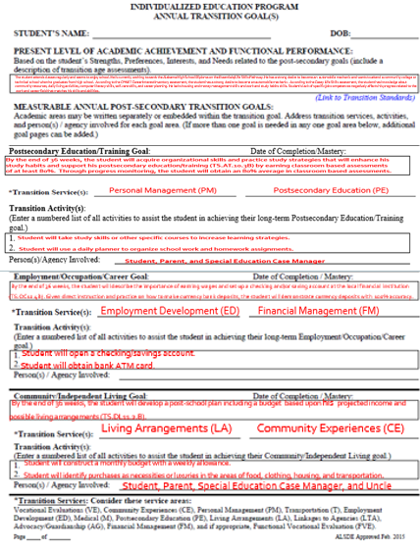

Slide 44
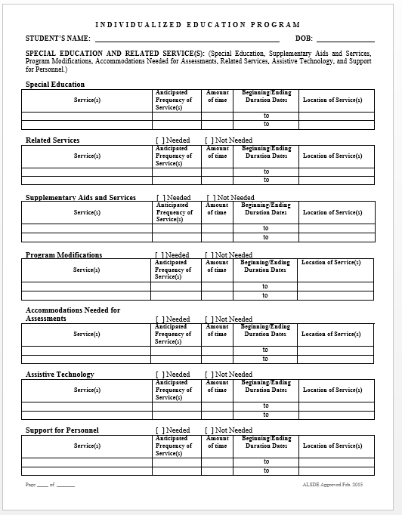
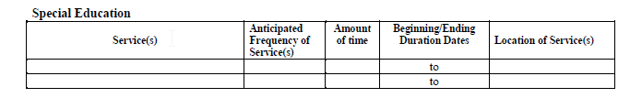
SPECIAL EDUCATION and RELATED SERVICES

Slide 45
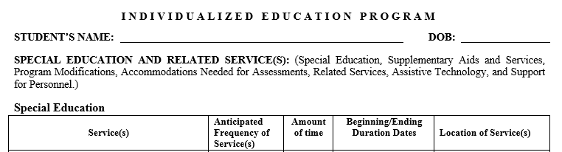
TRANSITION
The special education teacher will work one-on-one with student to provide direct instruction in learning strategies (i.e., context clues, word study, reading, information retrieval) to assist with comprehension deficits, and obtaining information relevant to his career choices.
Weekly
30
8/2015-5/2016
Resource Classroom
Notes:
Facilitator’s Notes:
Direct instruction using an evidence based reading program.
Special Education teacher will collaborate with general education teacher to prepare instructional supports for subject area text.

Slide 46
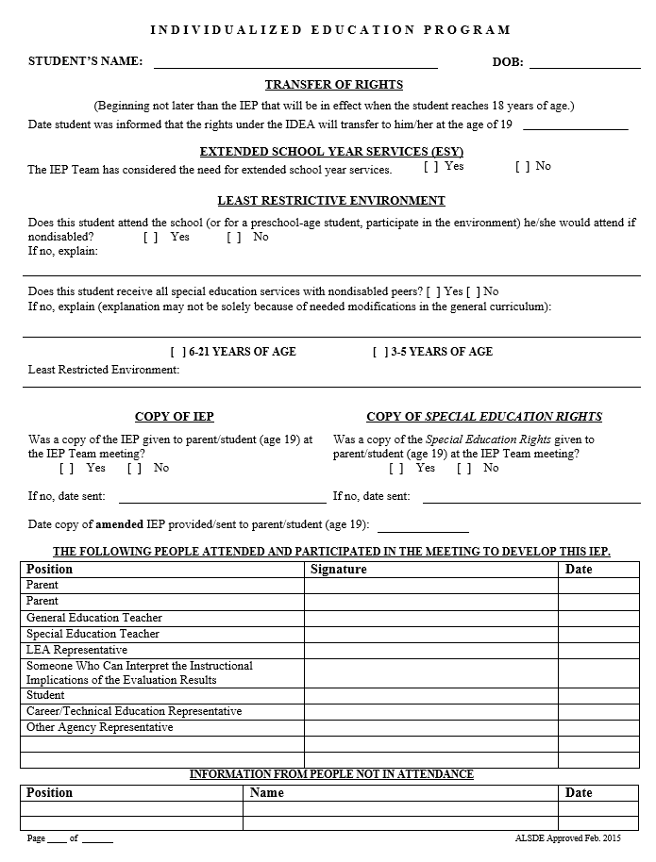
INDIVIDUALIZED EDUCATION PROGRAM SIGNATURE PAGE

Slide 47
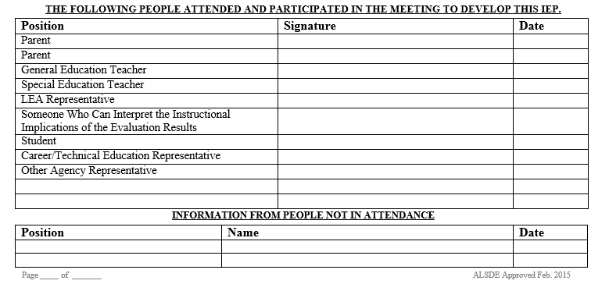
First and last name
Date
First and last name
Date
First and last name
Date
First and last name
Date
First and last name
Date
First and last name Date
First and last name
Date
First and last name
Date

Slide 48

Questions/Comments

Slide 49

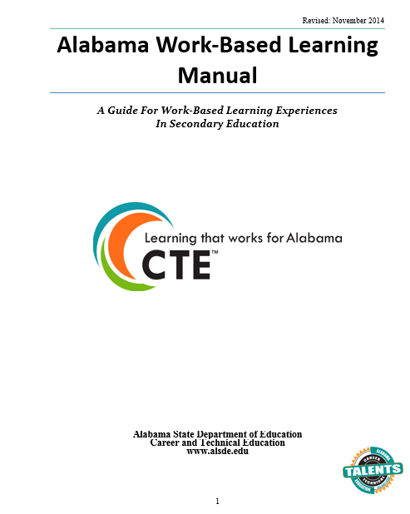
Resources
http://www.alsde.edu/sec/ses/Transition/AlabamaTransitionStandards-2014
http://web.alsde.edu/docs/documents/52/Work-BasedLearningManual201-
14-15.docx

Slide 50

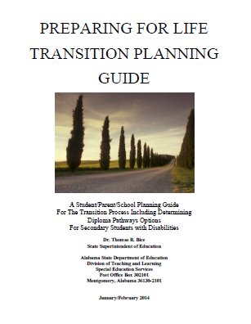
Resources
https://www.alsde.edu/sec/ses/Policy/Mastering the Maze.pdf
DISCLAIMER: This document will be updated March 2015
http://www.alsde.edu/sec/ses/Transition/Preparingforlifetransitionplanning
guide2014.doc
DISCLAIMER: This document will be updated March 2015

Slide 51
Website Resources
Alabama State Department of Education/Special Education Services
http://www.alsde.edu/sec/ses/Pages/home.aspx
National Center on Secondary Education and Transition
http://www.ncset.org/
National Collaborative on Workforce and Disability
http://www.ncwd-youth.info/
National Technical Assistance Center on Transition N-TACT
http://www.nsttac.org/
O*NET Online
http://www.onetonline.org/
Transition Coalition
http://transitioncoalition.org/transition/

Slide 52
Alabama State Department of Education
Every Child a Graduate. Every Graduate Prepared.
Crystal Richardson crystal@alsde.edu
Alicia Hodge ahodge@alsde.edu
Curtis Gage cgage@alsde.edu
Kemeche Green kgreen@alsde.edu
Diann Jones djones1@alsde.edu
Bernice Rush-Harrison brush-harrison@alsde.edu

