Slide 1
Switch Access
For Apple products

Slide 2
Kate Moseley AT Specialist
TASC employee that contracts with STAR to provide AT webinars and trainings
http://www.startraining.org/
Power Point
kmoseley@ucphuntsville.org

Slide 3
TASC and STAR
TASC
Technology Assistance for Special Consumers
AT consultations, evaluations, informational sessions, and Technical Assistance
Lending Library check out equipment for 2-3 weeks
Switches, mounts, adaptive toys, communication aids, aids to daily living, and computer keyboards, mice, and joystick adaptations
STAR
Alabama’s assistive technology resource
AT4ALL
http://al.at4all.com
Online database that provides current inventory of AT and medical equipment. You may also post want ads for items not listed.
Wheelchairs, Scooters, Shower/ Bath Aids, Beside Commodes, Hospital beds, Walkers and canes, ramps and lifts, and more.

Slide 4
Objectives
Locate Switch Access
Turn Switch Access on and off
Understand the settings of Switch Access
Blue Tooth & Adapter Switches

Slide 5
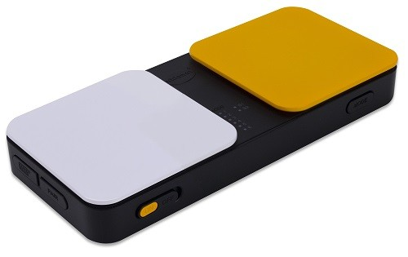
Switches
Pererro Switch interface
Many switches
RJ Cooper and Ablenet
User friendly
Many adaptaions
Blue 2
By Ablenet
Bluetooth
Wireless connection
Wired Switches
Tapio iOS and USB Switch Interface
Mac, iPad Air, iPad Mini, iPhone 5, iPhone 6
Pererro
Works directly with the iPhone or iPad
4th generation iPhone and iPod Touch, and iPad 2
Blue 2
Tapio

Slide 6
Blue Tooth
How do I set up blue tooth?
Having difficulties setting up to Bluetooth?
Make sure Blue Tooth device is fully charged
Turn off devices and turn it back on
“forget” the device then connect again
Tap the little “i” with a circle around it
Blue 2

Slide 7
Switch Interfaces
Do not work as switches by themselves
Need an external switch to work
Once connected
Settings -> general -> accessibility -> switch access
Set up your switch similar to the way we set up the bluetooth switch
switches -> new switch -> external
Make sure switch control is on and you are ready to go!

Slide 8
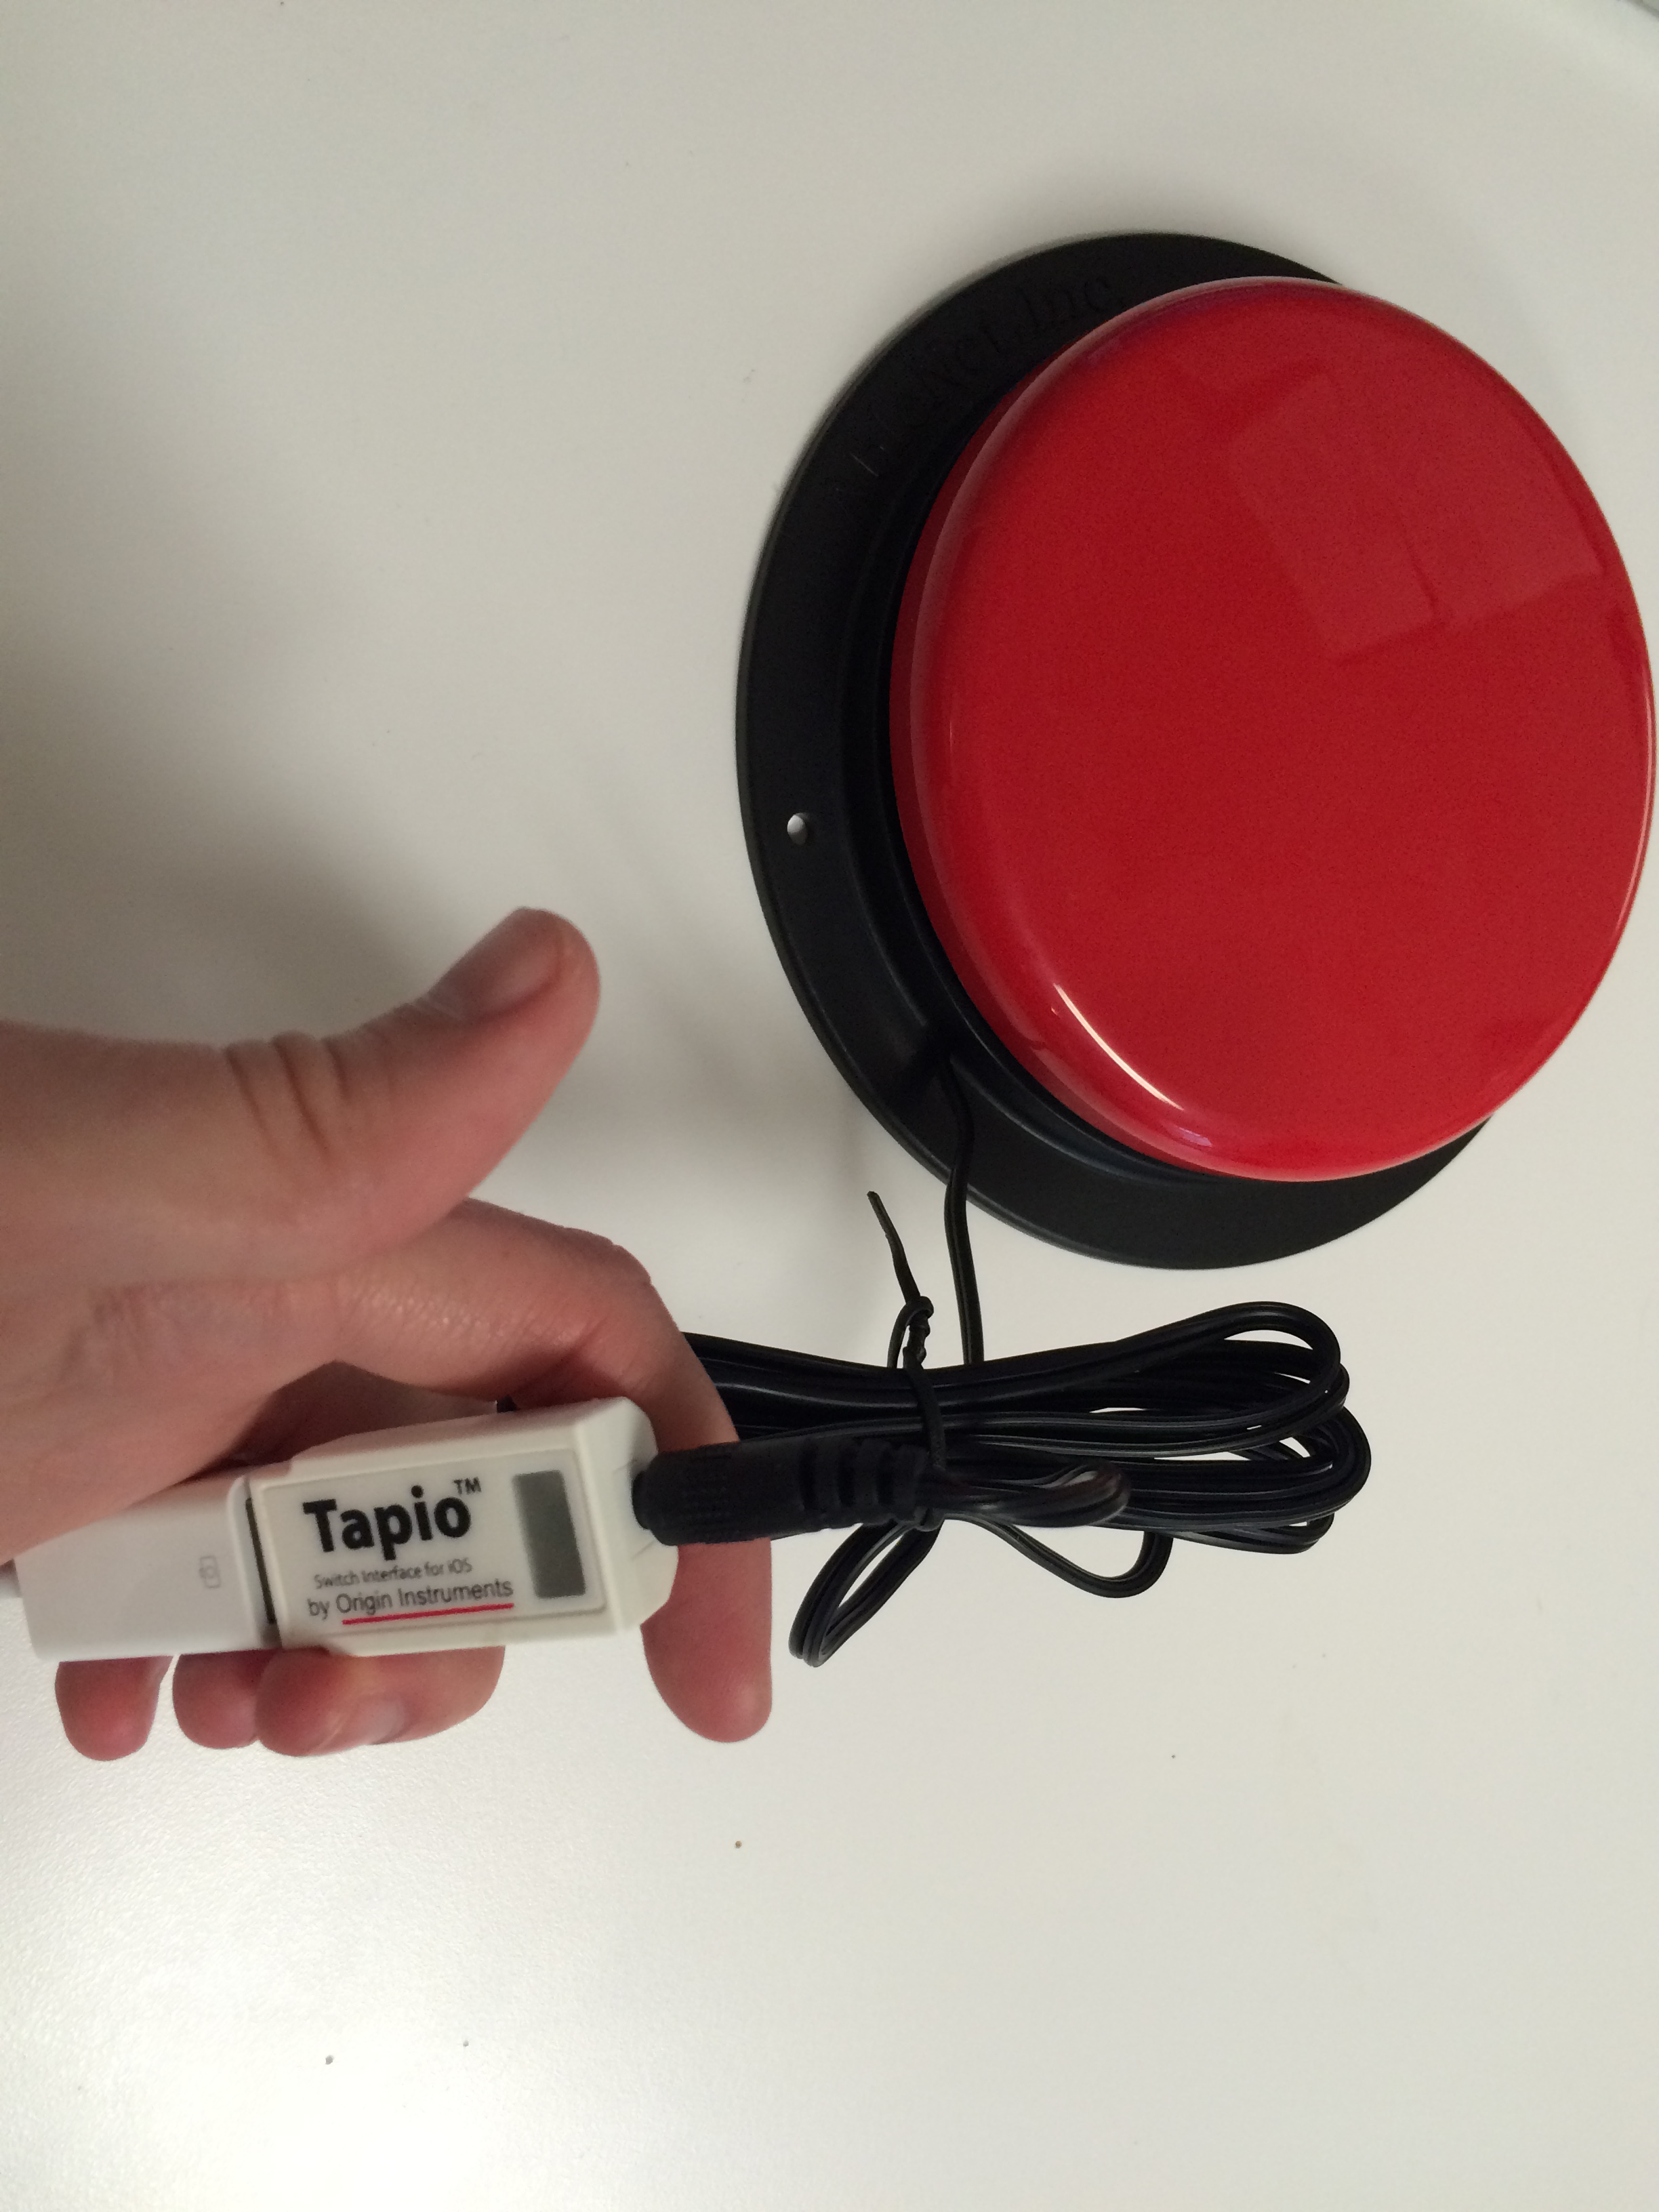
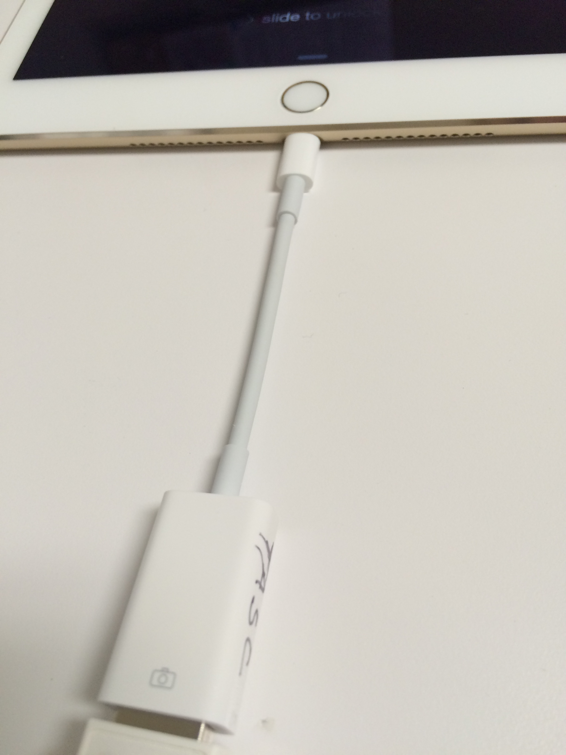
Tapio Switch
Versatile Switch
USB plug for computers
Lightning to USB Adaptor for Apple products
Lightning to USB adapter plugs into iPad
Tapio USB plugs into lightning adapter
Switch plugs into Tapio
Switch is ready to go
+
=
Note: when I plug in Tapio my iPad Air 2 says the switch is not compatible, but it works anyways. I ignore that notification and move on through the steps.

Slide 9
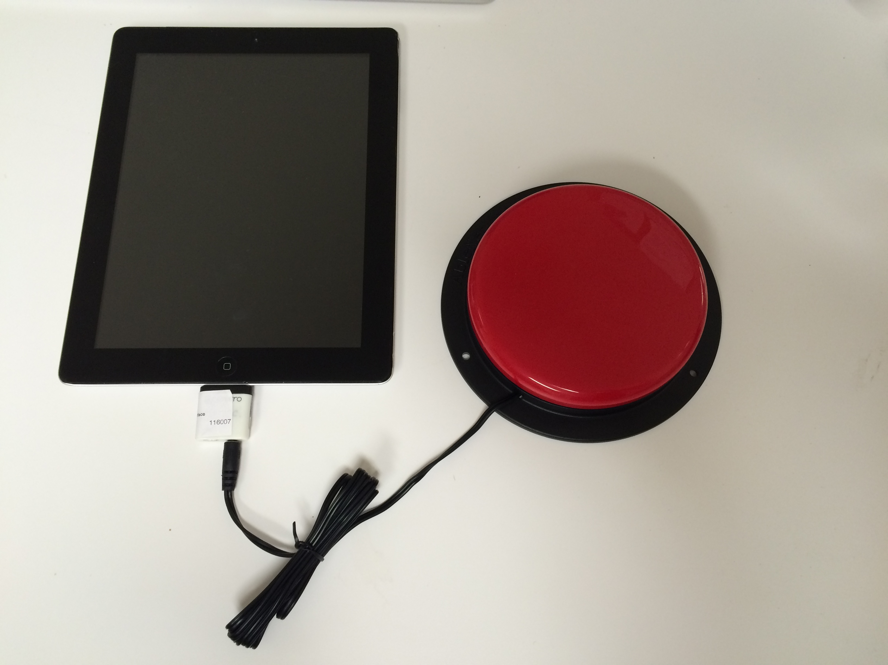
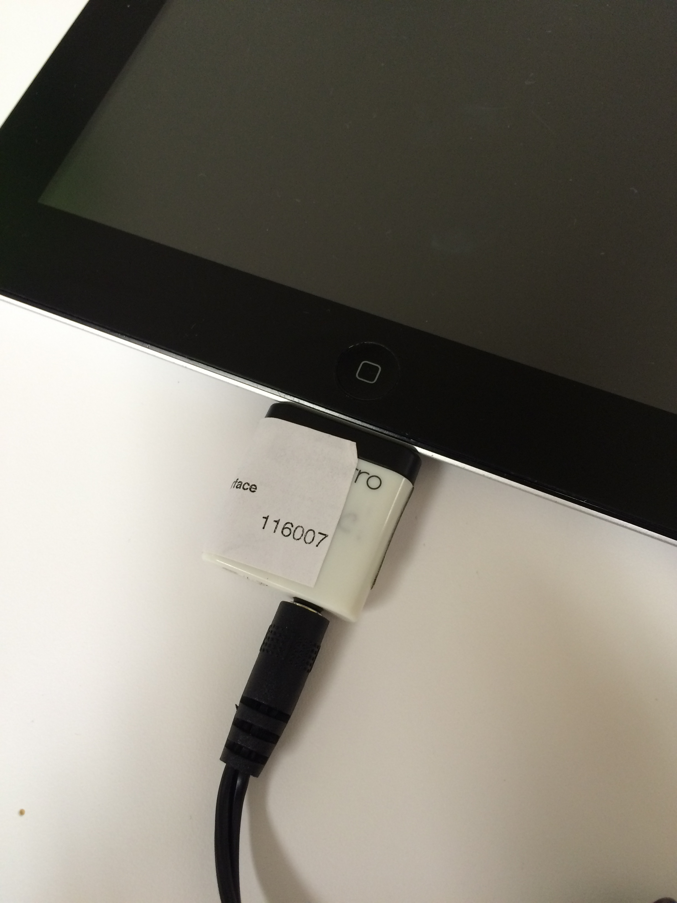
Pererro Switch
Plug in Pererro into bottom of iPad
Plug switch cable into Pererro
Switch is ready to go and functional through Switch Access!

