Slide 1
Accessibility and the iPad
Switch Access
Voice Over
Speech Access
And More!

Slide 2
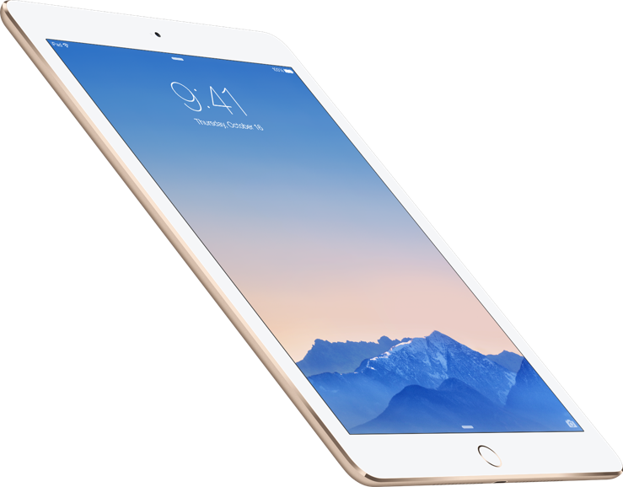
Overview
Accessibility features in Apple products with iOS 8.4
iPads 3 and above
iPhone 4s and above
Settings ->General ->Accessibility
Lost?
Tips under the buttons
Apple Accessibility

Slide 3
Accessibility Shortcut
Very Bottom of accessibility features
DO FIRST. SELECT ALL OPTIONS
Triple clicking the home button will bring up a menu
Turn accessibility settings off or on.

Slide 4
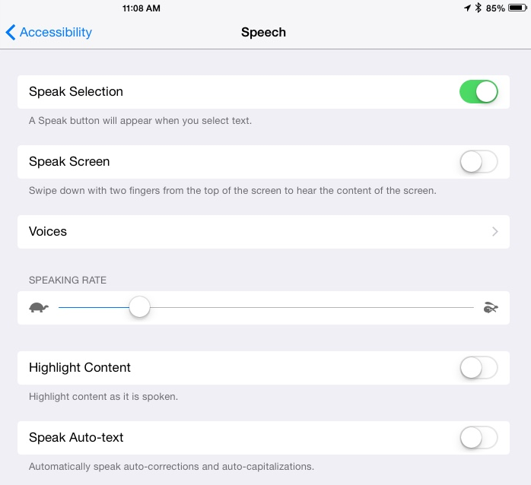
Speech
Speak Selection
Option to speak selected text
Speak Screen
2 finger swipe from top pf screen to hear content of screen
Change Voices
Highlight Context
Like karaoke
Speak Auto Text
Automatically speak corrected words
CAREFUL

Slide 5
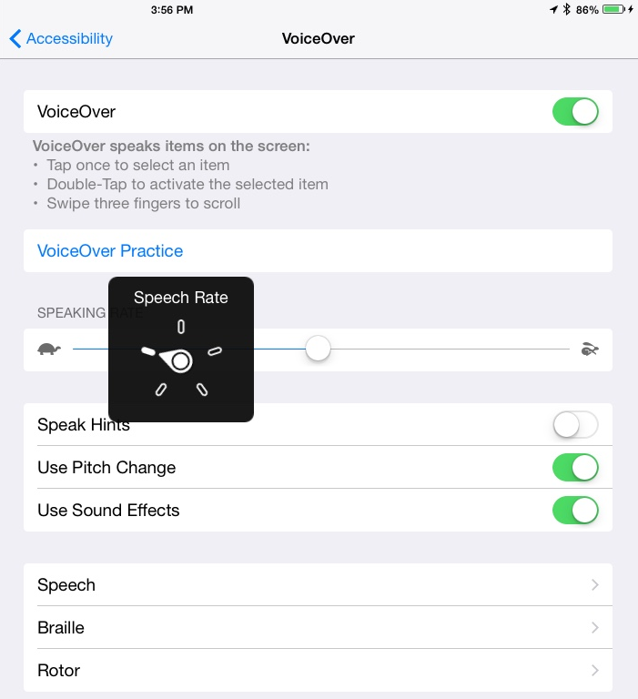
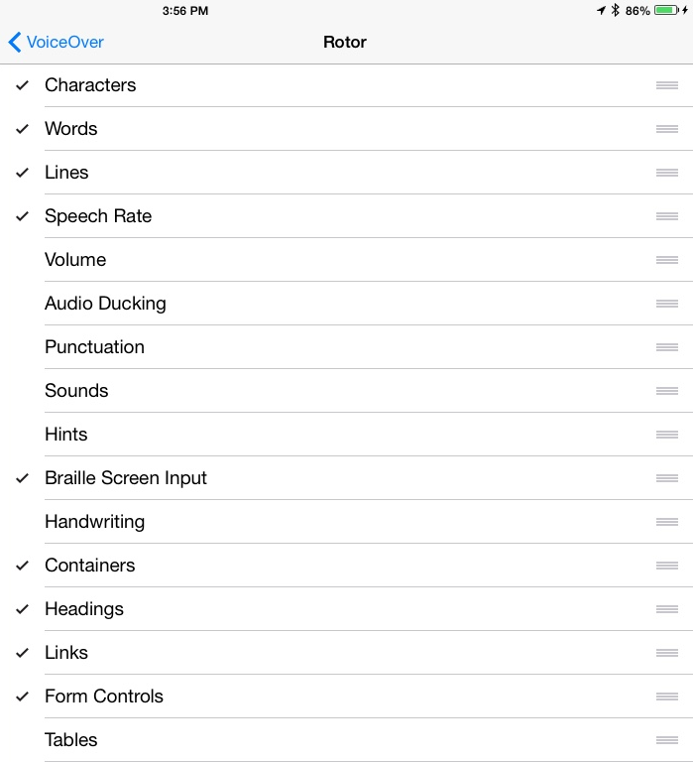
Voice Over
Speak Hints
Use Pitch Change
Use Sound Effects
Informs you when you switch what is on screens and such
Speech
Change languages and dialects
Alex
Typing Feedback
Speak Notifications
Large Cursor
Rotor
Turn two fingers as you would a dial to open up the Rotor
Rotor has shortcuts during voice over
Rotor Visual
Rotor Options

Slide 6
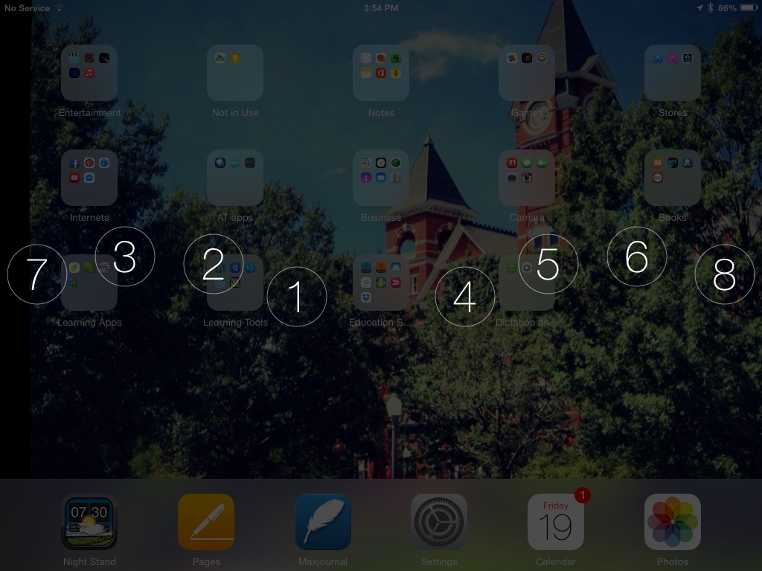
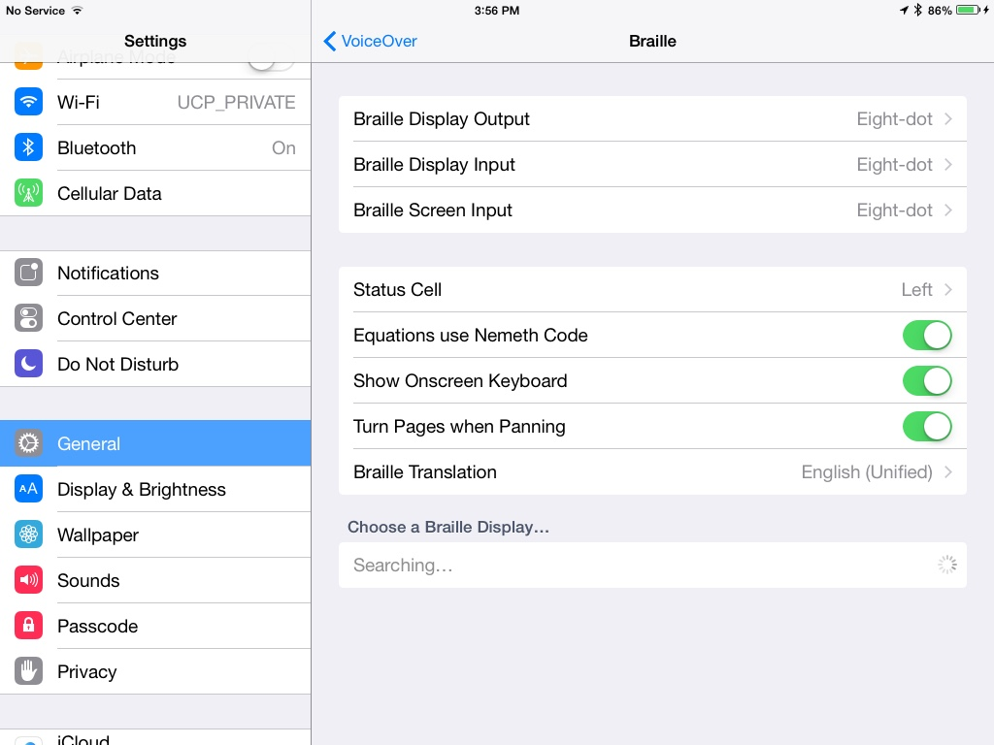
Voice Over Braille Display
Braille display without physical keyboard (1)
Braille display with a physical keyboard
Hook up with Bluetooth

Slide 7
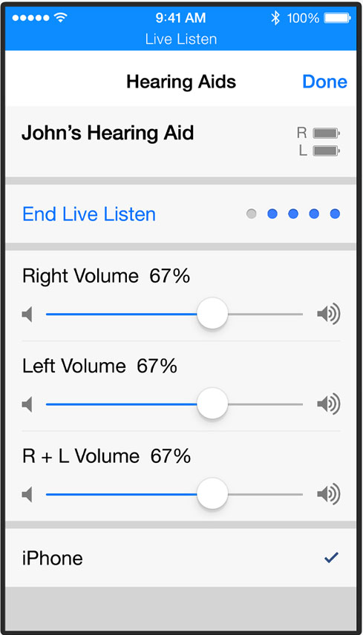
Hearing Basics
Facetime
Signing
Subtitles and Captioning
Siri
Speech to text on notes
Alternative Alerts
LED Flash
Vibrations
Hearing Aids
Audibel, Audigy, Beltone, Cochlear, MictoTech, NuEar, ReSound, Starkey
Bluetooth connection
Manage hearing aid from phone

Slide 8
Physical and Motor Skills
Siri 3rd Party Keyboard Support
Switch Access Dictation
Assistive Touch Keyboard shortcuts

Slide 9
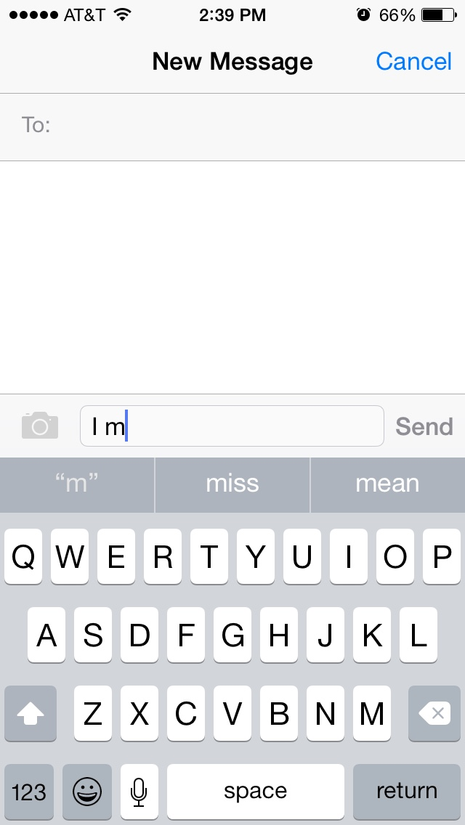
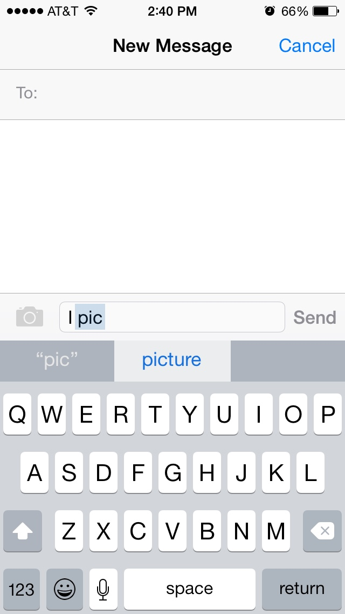
Basics
Word Prediction
Keyboard Shortcuts
Siri
When plugged into charger say “hey Siri”
“Open Maps”
Dictation
Tap little microphone for speech to text
Keyboards
3rd party support
Keyboard shortcuts LOL
Word Prediction
Siri

Slide 10
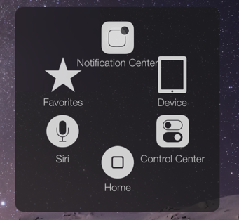
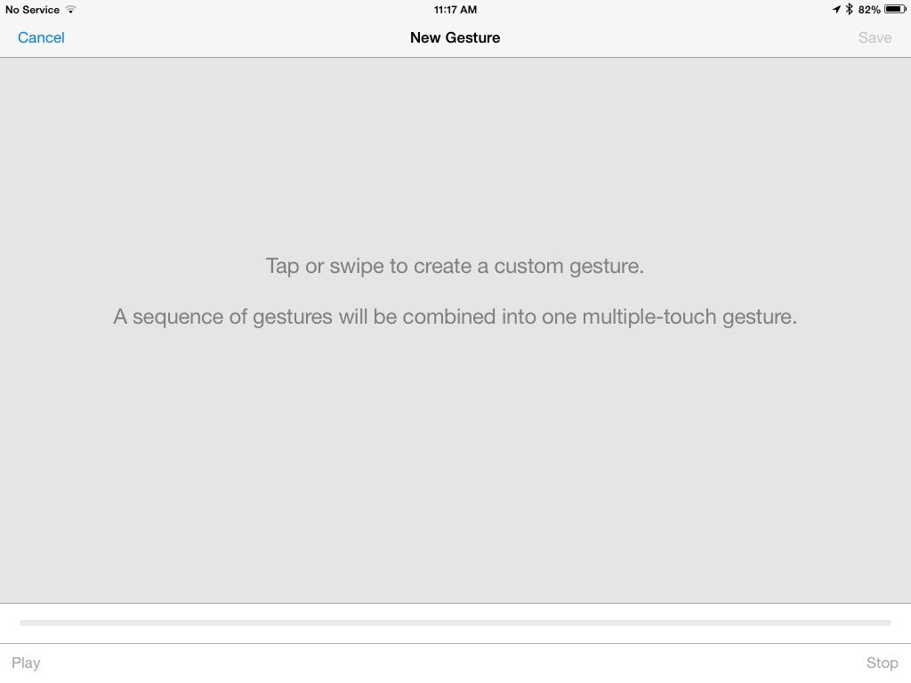
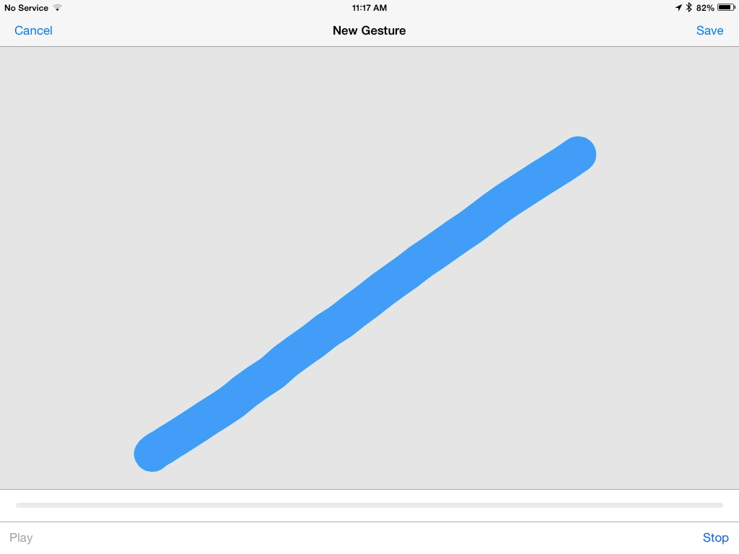
Assistive Touch
Creature gestures of your own
On every screen
Compatible with switches
Lock device, home button, shortcuts

Slide 11
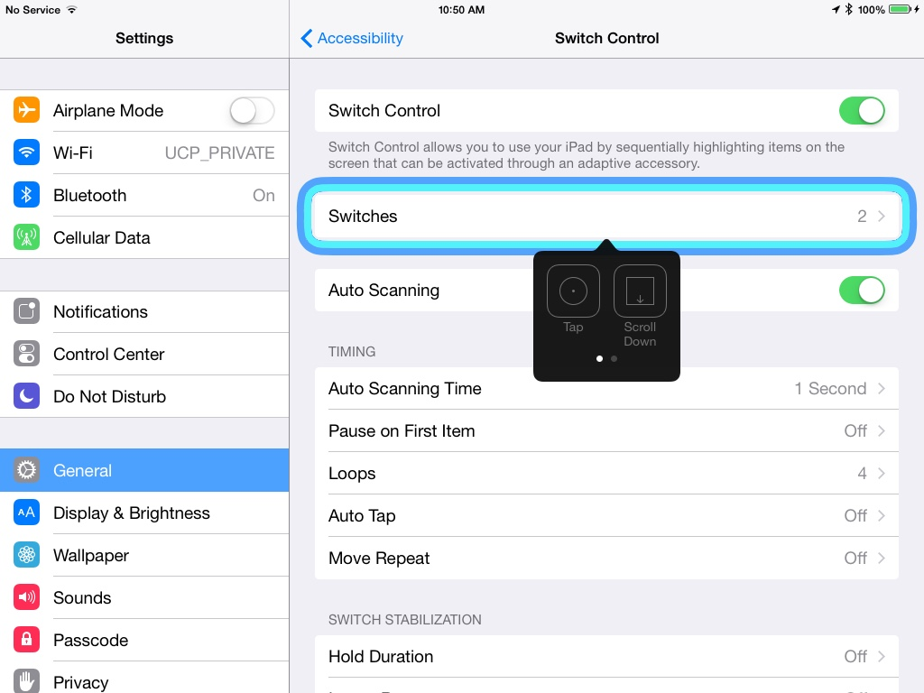
Switch Access
First Connect your device through
Bluetooth
Switch interfaces
Built in
Bluetooth
Switch interface
Built in camera
improving
Switch Control
Automatic or Do it yourself?
Cursor size
Timing
Loops

Slide 12
Questions?

